Slide 1


19EC786
Analog VLSI design

Slide 2
19EC786 – Analog VLSI design
Syllabus
UNIT I BASIC MOS DEVICES 9
Depletion region of PN junction - Band diagram of MOS capacitor – Accumulation, Depletion, inversion region- Large and small signal behavior of MOSFET- short channel effects in MOS transistors – weak inversion in MOS transistors- substrate current flow in MOS transistor.
UNIT II HIGH FREQUENCY CMOS AMPLIFIERS AND CURRENT MIRROR CIRCUITS 9
Common source, common drain, common gate. Differential amplifiers-Cascode amplifiers-Current amplifiers–power amplifiers- Current sources and sinks ,MOS Current Mirrors – Simple, Cascode, Wilson and Widlar current source.
UNIT III CMOS OPERATIONAL AMPLIFIER 9
Design of CMOS Op amps - Compensation of Op amps- Low voltage Op amps - Low noise Op amps Two stage MOS Operational Amplifiers with Cascode, MOS Telescopic - Cascode Operational Amplifier, MOS Folded Cascode and MOS Active Cascode Operational Amplifiers.
UNITIV COMPARATORS AND SWITCHED CAPACITOR CIRCUITS 9
Characterization of a Comparator -two-Stage Open-Loop Comparators - Improving the Performance of Open-Loop Comparators-Discrete-Time Comparators - High-Speed Comparators- Switched Capacitor Circuits – Switched Capacitor Amplifiers - Switched Capacitor Integrators
UNITV A/D AND D/A CONVERTERS 9
Characterization of D/A converters- Parallel D/A converters-extending the resolution of parallel D/A converters- Serial D/A converters- Characterization of A/D converters-Serial A/D converters- Medium and high speed A/D converters.

Slide 3
UNIT II HIGH FREQUENCY CMOS AMPLIFIERS AND CURRENT MIRROR CIRCUITS
UNIT II HIGH FREQUENCY CMOS AMPLIFIERS AND CURRENT MIRROR CIRCUITS
Common source, common drain, common gate.
Differential amplifiers
Cascode amplifiers
Current amplifiers
Power amplifiers
Current sources and sinks
MOS Current Mirrors
Simple, Cascode, Wilson and Widlar current source.

Slide 4
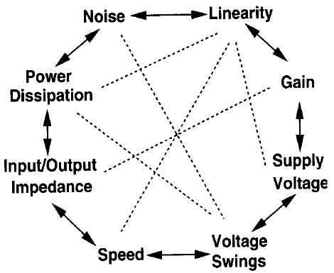
UNIT II HIGH FREQUENCY CMOS AMPLIFIERS AND CURRENT MIRROR CIRCUITS
Single Stage Amplifiers
What aspects of the performance of an amplifier are important?
Gain, speed, power dissipation, supply voltage, linearity, noise, or maximum voltage swing, input and output impedances
Analog design octagon

Slide 5
UNIT II HIGH FREQUENCY CMOS AMPLIFIERS AND CURRENT MIRROR CIRCUITS
Single Stage Amplifiers
Common-Source
Common-Source Stage with Resistive Load
CS Stage with Diode-Connected Load
CS Stage with Current-Source Load
CS Stage with Triode Load
CS Stage with Source Degeneration
Source Follower
Common-Gate Stage

Slide 6
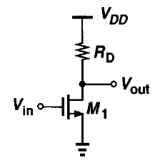

UNIT II HIGH FREQUENCY CMOS AMPLIFIERS AND CURRENT MIRROR CIRCUITS
Common-Source Amplifier
A MOSFET converts variations in its gate-source voltage to a small-signal drain current, which can pass through a resistor to generate an output voltage.
The input impedance of the circuit is very high at low frequencies.
Case i: (Cut off region)
If the input voltage is Zero, M₁ is Off and
V_{out} = V_{DD}
------- (1)
Case ii: (Saturation region)
If the input voltage is Vth, M₁ is ON and drawing current from R_{D}, then
V_{out} = V_{DD} - I_{D} R_{D}
------- (2)
------- (3)
Here, Channel length modulation is neglected.

Slide 7
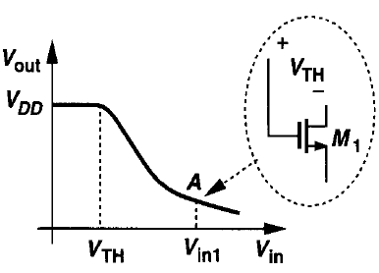

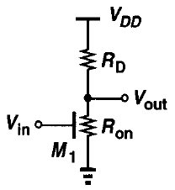

UNIT II HIGH FREQUENCY CMOS AMPLIFIERS AND CURRENT MIRROR CIRCUITS
Common-Source Amplifier
Further increasing V_{in}, then V_{out} decreases. The MOSFET is in saturations regions until V_{in1} at point A (Fig.),
V_{out} = V_{in1} - V_{th}
------- (4)
From (3) and (4)
------- (5)
Case iii: (Linear region)
From (2),
------- (6)

Slide 8





UNIT II HIGH FREQUENCY CMOS AMPLIFIERS AND CURRENT MIRROR CIRCUITS
Common-Source Amplifier
Further increasing V_{in}, then V_{out} decreases below 2(V_{in} – V_{th}) and V_{out} ,
------- (7)
Small signal Gain:
From (3), Av is
------- (9)

Slide 9
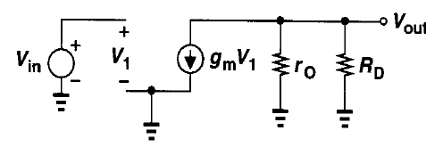


UNIT II HIGH FREQUENCY CMOS AMPLIFIERS AND CURRENT MIRROR CIRCUITS
Common-Source Amplifier
Small signal Equivalent Circuit:
From the above, V_{out} is,
V_{out} = -g_{m}V_{gs} (r₀ || R_{D})
------- (10)
Since, V_{in} = V_{gs}or V₁;
A_{v} = V_{out} / V_{in}
------- (11)
------- (12)
------- (12)

Slide 10
UNIT II HIGH FREQUENCY CMOS AMPLIFIERS AND CURRENT MIRROR CIRCUITS
Common-Source Amplifier with Diode-Connected Load
In many CMOS technologies, it is difficult to fabricate resistors with tightly-controlled values or a reasonable physical size.
Consequently, it is desirable to replace R_{D} with a MOS transistor.
Types of Active Loads,
CS with Diode Connected Load
CS with Current Source Load
CS with Triode Load
CS with Source Degeneration
Types of Diode Connected Loads,
CS with NMOS driver with NMOS Enhancement Load
CS with NMOS driver with PMOS Enhancement Load
CS with PMOS driver with NMOS Enhancement Load
CS with PMOS driver with PMOS Enhancement Load
CS with NMOS driver with NMOS Depletion Load
CS with NMOS driver with PMOS Depletion Load
CS with PMOS driver with NMOS Depletion Load
CS with PMOS driver with PMOS Enhancement Load

Slide 11
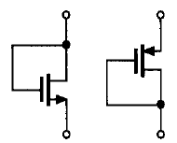
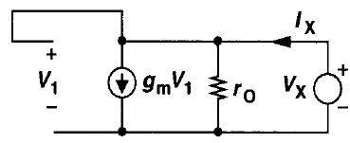

UNIT II HIGH FREQUENCY CMOS AMPLIFIERS AND CURRENT MIRROR CIRCUITS
Common-Source Amplifier with Diode-Connected Load
A MOSFET can operate as a small-signal resistor if its gate and drain are shorted.
It called a "diode-connected" device, this configuration exhibits a small-signal behavior similar to a two-terminal resistor.
The transistor is always in saturation because the drain and the gate have the same potential.
Diode-connected
NMOS and PMOS,
Small signal equivalent circuit
If no Body-effect exists…
The impedance of the diode is simply equal to

Slide 12

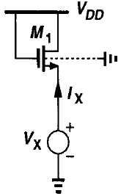
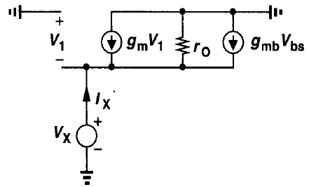




UNIT II HIGH FREQUENCY CMOS AMPLIFIERS AND CURRENT MIRROR CIRCUITS
Common-Source Amplifier with Diode-Connected Load
If Body-effect exists…
The impedance of the diode connected transistor is equal to (Apply KCL)

Slide 13
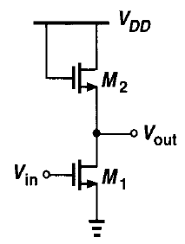
UNIT II HIGH FREQUENCY CMOS AMPLIFIERS AND CURRENT MIRROR CIRCUITS
1. CS with NMOS driver with NMOS Enhancement Load
Body effect in M₂ is,
Load (Saturation Region)
Body effect Exists
V_{bs} = V_{b} – V_{s} = 0 – V_{s} = -V_{s}
Equivalent circuit for Load is,
Driver
D₂
G₂
r_{o2}
g_{m2} V_{gs2}
g_{mb2} V_{bs2}
S₂
V_{x}
Supply is grounded for R₀ calculation. Hence, V_{g2} = 0.
S₁

Slide 14
UNIT II HIGH FREQUENCY CMOS AMPLIFIERS AND CURRENT MIRROR CIRCUITS
1. CS with NMOS driver with NMOS Enhancement Load
Applying KCL at S₂ of the equivalent circuit is,
I_{x} + g_{m2} V_{gs2} + g_{mb2} V_{bs2} = V_{x}/r_{o2}
------- (1)
I_{x} + g_{m2} (V_{g2} - V_{s2}) + g_{mb2} (V_{b2} - V_{s2}) = V_{x}/r_{o2}
------- (2)
Using, η = g_{mb}/ g_{m}
I_{x} + g_{m2} (V_{g2} - V_{s2}) + ηg_{m2} (V_{b2} - V_{s2}) = V_{x}/r_{o2}
------- (3)
Since V_{g2} = V_{b2} = 0; V_{s2} = V_{x}
I_{x} – g_{m2} (0 - V_{x}) – ηg_{m2} (0 - V_{x}) = V_{x}/r_{o2}
------- (4)
I_{x} - (V_{x}) (g_{m2} + ηg_{m2}) = V_{x}/r_{o2}
------- (5)
I_{x} = (V_{x}) (g_{m2} + ηg_{m2}) +V_{x}/r_{o2}
------- (6)
R_{OL} = V_{x} /I_{x} = r_{o2} || (1/(g_{m2}(1 + η))
------- (7)
Since, r_{o2} >> (1/(g_{m2}(1 + η))
R_{OL} = (1/(g_{m2}(1 + η))
------- (8)

Slide 15
UNIT II HIGH FREQUENCY CMOS AMPLIFIERS AND CURRENT MIRROR CIRCUITS
1. CS with NMOS driver with NMOS Enhancement Load
Equivalent circuit for Driver is,
D₁
G₁
V_{out}
From the equivalent circuit,
V_{in}
r_{o1}
R_{OL}
V_{out} = - g_{m1} V_{gs1} (r_{o1} || R_{OL})
------- (9)
g_{m1} V_{gs1}
Using (8) in (9),
V_{out} = - g_{m1} V_{gs1} (r_{o1} || (1/(g_{m2}(1 + η)))
------- (10)
S₁
Using V_{gs1} = V_{in} in (10),
A_{v} = V_{out}/V_{in} = - g_{m1} (r_{o1} || (1/(g_{m2}(1 + η)))
------- (11)
Since, r_{o1} >> (1/(g_{m}(1 + η)),
A_{v} = - g_{m1} /(g_{m2}(1 + η))
------- (12)
Using g_{m} = √(2I_{D}μ_{n}C_{ox}(W/L)) in (12),
A_{v} = - {√(2I_{D}μ_{n}C_{ox}(W/L)₁) /((1 + η) √(2I_{D}μ_{n}C_{ox}(W/L)₂)))}
------- (13)
A_{v} = - {√((W/L)₁ /((1 + η) √(W/L)₂))}
------- (14)

Slide 16
UNIT II HIGH FREQUENCY CMOS AMPLIFIERS AND CURRENT MIRROR CIRCUITS
2. CS with NMOS driver with PMOS Enhancement Load
V_{DD}
Equivalent circuit for Load is,
S₂
V_{out}
G₂
M₂
PMOS Load
(No Body Effect)
D₂
G₂
D₂
V_{out}
D₁
V_{x}
G₁
r_{o2}
M₁
NMOS Driver
g_{m2} V_{gs2}
V_{in}
S₁
S₂
S₁

Slide 17
UNIT II HIGH FREQUENCY CMOS AMPLIFIERS AND CURRENT MIRROR CIRCUITS
2. CS with NMOS driver with PMOS Enhancement Load
Applying KCL at V_{out} of the equivalent circuit is,
I_{x} + g_{m2} V_{sg2} = V_{x}/r_{o2}
------- (1)
I_{x} + g_{m2} (V_{s2} - V_{g2}) = V_{x}/r_{o2}
------- (2)
Since V_{s2} = V_{b2} = 0; V_{g2} = V_{x}
I_{x} + g_{m2} (0 - V_{x}) = V_{x}/r_{o2}
------- (3)
I_{x} - (V_{x}) (g_{m2}) = V_{x}/r_{o2}
------- (4)
I_{x} = (V_{x}) (g_{m2}) +V_{x}/r_{o2}
------- (5)
R_{OL} = V_{x} /I_{x} = r_{o2} || (1/(g_{m2}))
------- (6)
Since, r_{o2} >> (1/(g_{m2}))
R_{OL} = (1/(g_{m2}))
------- (7)

Slide 18
UNIT II HIGH FREQUENCY CMOS AMPLIFIERS AND CURRENT MIRROR CIRCUITS
2. CS with NMOS driver with PMOS Enhancement Load
Equivalent circuit for Driver is,
D₁
G₁
V_{out}
From the equivalent circuit,
V_{in}
r_{o1}
R_{OL}
V_{out} = - g_{m1} V_{gs1} (r_{o1} || R_{OL})
------- (8)
g_{m1} V_{gs1}
Using (7) in (8),
V_{out} = - g_{m1} V_{gs1} (r_{o1} || (1/(g_{m}(1 + η)))
------- (9)
S₁
Using V_{gs1} = V_{in} in (9),
A_{v} = V_{out}/V_{in} = - g_{m1} (r_{o1} || (1/(g_{m2}))
------- (10)
Since, r_{o1} >> (1/(g_{m}(1 + η)),
A_{v} = - g_{m1} /(g_{m2})
------- (11)
Using g_{m} = √(2I_{D}μ_{n}C_{ox}(W/L)) in (12),
A_{v} = - {√(2I_{D}μ_{n}C_{ox}(W/L)₁) /( √(2I_{D}μ_{n}C_{ox}(W/L)₂))}
------- (12)
A_{v} = - {√((W/L)₁) /(√(W/L)₂))}
------- (13)

Slide 19
UNIT II HIGH FREQUENCY CMOS AMPLIFIERS AND CURRENT MIRROR CIRCUITS
3. CS with PMOS driver with NMOS Enhancement Load
V_{DD}
Equivalent circuit for Load is,
G₁
S₁
D₂
V_{out}
M₁
PMOS Driver
G₂
D₁
V_{in}
V_{out}
D₂
V_{x}
M₂
r_{o2}
G₂
NMOS Load
(No Body Effect)
g_{m2} V_{gs2}
S₂
S₂
S₁

Slide 20
UNIT II HIGH FREQUENCY CMOS AMPLIFIERS AND CURRENT MIRROR CIRCUITS
3. CS with PMOS driver with NMOS Enhancement Load
Applying KCL at V_{out} or at D₂ of the equivalent circuit is,
I_{x} = g_{m2} V_{gs2} + V_{x}/r_{o2}
------- (1)
I_{x} = g_{m2} (V_{g2} - V_{s2}) + V_{x}/r_{o2}
------- (2)
Since V_{s2} = V_{b2} = 0 (GND); V_{g2} = V_{x}
I_{x} = g_{m2} (V_{x} - 0) + V_{x}/r_{o2}
------- (3)
I_{x} = (V_{x}) (g_{m2}) + V_{x}/r_{o2}
------- (4)
I_{x} = (V_{x}) (g_{m2}) +V_{x}/r_{o2}
------- (5)
R_{OL} = V_{x} /I_{x} = r_{o2} || (1/(g_{m2}))
------- (6)
Since, r_{o2} >> (1/(g_{m2}))
R_{OL} = (1/(g_{m2}))
------- (7)

Slide 21
UNIT II HIGH FREQUENCY CMOS AMPLIFIERS AND CURRENT MIRROR CIRCUITS
3. CS with PMOS driver with NMOS Enhancement Load
Equivalent circuit for Driver is,
D₁
G₁
V_{out}
From the equivalent circuit,
V_{in}
r_{o1}
R_{OL}
V_{out} = - g_{m1} V_{gs1} (r_{o1} || R_{OL})
------- (8)
g_{m1} V_{gs1}
Using (7) in (8),
V_{out} = - g_{m1} V_{gs1} (r_{o1} || (1/(g_{m}(1 + η)))
------- (9)
S₁
Using V_{gs1} = V_{in} in (9),
A_{v} = V_{out}/V_{in} = - g_{m1} (r_{o1} || (1/(g_{m2}))
------- (10)
Since, r_{o1} >> (1/(g_{m}(1 + η)),
A_{v} = - g_{m1} /(g_{m2})
------- (11)
Using g_{m} = √(2I_{D}μ_{n}C_{ox}(W/L)) in (12),
A_{v} = - {√(2I_{D}μ_{n}C_{ox}(W/L)₁) /( √(2I_{D}μ_{n}C_{ox}(W/L)₂))}
------- (12)
A_{v} = - {√((W/L)₁) /(√(W/L)₂))}
------- (13)

Slide 22
UNIT II HIGH FREQUENCY CMOS AMPLIFIERS AND CURRENT MIRROR CIRCUITS
4. CS with PMOS driver with PMOS Enhancement Load
V_{DD}
Equivalent circuit for Load is,
S₁
D₂
G₁
G₂
M₁
PMOS Driver
D₁
V_{in}
V_{out}
r_{o2}
D₂
G₂
M₂
g_{m2} V_{sg2}
g_{mb2} V_{sb2}
PMOS Load
(No Body Effect)
S₂
S₂
V_{x}
Supply is grounded for R₀ calculation. Hence, V_{g2} = 0.
S₁

Slide 23
UNIT II HIGH FREQUENCY CMOS AMPLIFIERS AND CURRENT MIRROR CIRCUITS
4. CS with PMOS driver with PMOS Enhancement Load
Applying KCL at S₂ of the equivalent circuit is,
I_{x} = g_{m2} V_{sg2} + g_{mb2} V_{sb2} + V_{x}/r_{o2}
------- (1)
I_{x} = g_{m2} (V_{s2} - V_{g2}) + g_{mb2} (V_{s2} - V_{b2}) + V_{x}/r_{o2}
------- (2)
Using, η = g_{mb}/ g_{m}
I_{x} = g_{m2} (V_{s2} - V_{g2}) + ηg_{m2} (V_{s2} - V_{b2}) - V_{x}/r_{o2}
------- (3)
Since V_{g2} = 0; V_{s2} = V_{x} ; V_{b2} = connected to V_{DD}
I_{x} = g_{m2} (V_{x} - 0) + ηg_{m2} (V_{x} - 0) + V_{x}/r_{o2}
------- (4)
I_{x} = (V_{x}) (g_{m2} + ηg_{m2}) + V_{x}/r_{o2}
------- (5)
I_{x} = (V_{x}) (g_{m2} + ηg_{m2}) +V_{x}/r_{o2}
------- (6)
R_{OL} = V_{x} /I_{x} = r_{o2} || (1/(g_{m2}(1 + η))
------- (7)
Since, r_{o2} >> (1/(g_{m2}(1 + η))
R_{OL} = (1/(g_{m2}(1 + η))
------- (8)

Slide 24
UNIT II HIGH FREQUENCY CMOS AMPLIFIERS AND CURRENT MIRROR CIRCUITS
4. CS with PMOS driver with PMOS Enhancement Load
Equivalent circuit for Driver is,
D₁
G₁
V_{out}
From the equivalent circuit,
V_{in}
r_{o1}
R_{OL}
V_{out} = g_{m1} V_{sg1} (r_{o1} || R_{OL})
------- (9)
g_{m1} V_{gs1}
Using (8) in (9),
V_{out} = -g_{m1} V_{sg1} (r_{o1} || (1/(g_{m2}(1 + η)))
------- (10)
S₁
Using V_{sg1} = 0-V_{in} in (10),
A_{v} = - V_{out}/V_{in} = - g_{m1} (r_{o1} || (1/(g_{m2}(1 + η)))
------- (11)
Since, r_{o1} >> (1/(g_{m}(1 + η)),
A_{v} = - g_{m1} /(g_{m2}(1 + η))
------- (12)
Using g_{m} = √(2I_{D}μ_{n}C_{ox}(W/L)) in (12),
A_{v} = - {√(2I_{D}μ_{n}C_{ox}(W/L)₁) /((1 + η) √(2I_{D}μ_{n}C_{ox}(W/L)₂)))}
------- (13)
A_{v} = - {√((W/L)₁ /((1 + η) √(W/L)₂))}
------- (14)

Slide 25
UNIT II HIGH FREQUENCY CMOS AMPLIFIERS AND CURRENT MIRROR CIRCUITS
5. CS with PMOS driver with PMOS Depletion Load
R_{OL} = (1/(g_{m2} η))
A_{v} = - g_{m1} /(g_{m2} η)
5. CS with NMOS driver with PMOS Depletion Load
R_{OL} = r_{o2}
A_{v} = - g_{m1} (r_{o1} || r_{o2})
6. CS with PMOS driver with NMOS Depletion Load
R_{OL} = r_{o2}
A_{v} = - g_{m1} (r_{o1} || r_{o2})
5. CS with NMOS driver with NMOS Depletion Load
R_{OL} = (1/(g_{m2} η))
A_{v} = - g_{m1} /(g_{m2} η)

Slide 26
UNIT II HIGH FREQUENCY CMOS AMPLIFIERS AND CURRENT MIRROR CIRCUITS
CS with Source Degeneration
A diode-connected load provides linear behavior for CS stage.
This can be accomplished by placing a "degeneration” resistor in series with the source terminal.
“Degeneration” is just another name for negative feedback
Why is there the need of degeneration resistor in CS stage?
As the input to the gate goes more positive the current through the degeneration resistor in the source circuit increases, reducing the gate-to-source voltage slightly (Vgs=Vg-Vs). This is series negative feedback… it reduces the overall gain, increases linearity, and increases the amplifier's effective output impedance.
What is source degeneration mean?
The addition of a circuit element between a transistor source and ground, with several effects, including a reduction in gain.

Slide 27
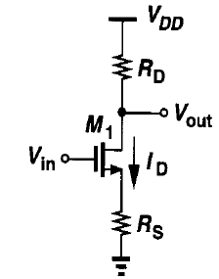
UNIT II HIGH FREQUENCY CMOS AMPLIFIERS AND CURRENT MIRROR CIRCUITS
CS with Source Degeneration
Equivalent circuit is,
D
x
I_{out}
G
V_{out}
I_{r0}
I_{D}
V_{in}
r_{o}
g_{m} V_{gs}
g_{mb} V_{bs}
R_{D}
V_{out}
S
I_{out}
R_{s}

Slide 28
UNIT II HIGH FREQUENCY CMOS AMPLIFIERS AND CURRENT MIRROR CIRCUITS
CS with Source Degeneration
From the equivalent circuit,
V_{out} = Voltage drop across r₀ + Voltage drop across R_{s}.
V_{out} = I_{r0} r₀ + I_{out} R_{s} ------- (1)
Whereas,
I_{out} = 0 – V_{out}/R_{D} ------- (2)
Sub (2) in (1), we get,
V_{out} = I_{r0} r₀ – (V_{out} R_{s} /R_{D}) ------- (3)

Slide 29
UNIT II HIGH FREQUENCY CMOS AMPLIFIERS AND CURRENT MIRROR CIRCUITS
CS with Source Degeneration
Applying KCL at node ‘x’ of the equivalent circuit is,
I_{r0} + g_{m} V_{gs} + g_{mb} V_{bs} = I_{out}
------- (4)
I_{r0} + g_{m} (V_{g} –V_{s} ) + g_{mb} (V_{b} - V_{s}) = -V_{out}/R_{D}
------- (5)
Using, η = g_{mb}/ g_{m}; V_{b} = 0; V_{g} = V_{in}; V_{s} = -V_{out} R_{s}/R_{D}
I_{r0} + g_{m} V_{in} + g_{m} V_{out} R_{s}/R_{D} + ηg_{m} (0 + V_{out} R_{s}/R_{D}) = -V_{out}/R_{D}
------- (6)
I_{r0} = -g_{m} V_{in} - g_{m} V_{out} R_{s}/R_{D} - ηg_{m} ( V_{out} R_{s}/R_{D}) -V_{out}/R_{D}
------- (7)
Sub., (7) in (3),
V_{out} = [-g_{m} V_{in} - g_{m} V_{out} R_{s}/R_{D} - ηg_{m} ( V_{out} R_{s}/R_{D}) -V_{out}/R_{D} ]r₀ – (V_{out} R_{s} /R_{D})
V_{out} + g_{m} r₀ V_{out} R_{s}/R_{D} + ηg_{m} r₀( V_{out} R_{s}/R_{D}) +V_{out} r₀ /R_{D} + (V_{out} R_{s} /R_{D}) = -g_{m} V_{in} r₀
V_{out} [1+ g_{m} r₀ R_{s}/R_{D} + ηg_{m} r₀(R_{s}/R_{D}) + r₀ /R_{D} + (R_{s} /R_{D})] = -g_{m} V_{in} r₀
A_{v} =V_{out} / V_{in} = -g_{m} r₀ / [1+ g_{m} r₀ R_{s}/R_{D} + ηg_{m} r₀(R_{s}/R_{D}) + r₀ /R_{D} + (R_{s} /R_{D})]
------- (8)

Slide 30
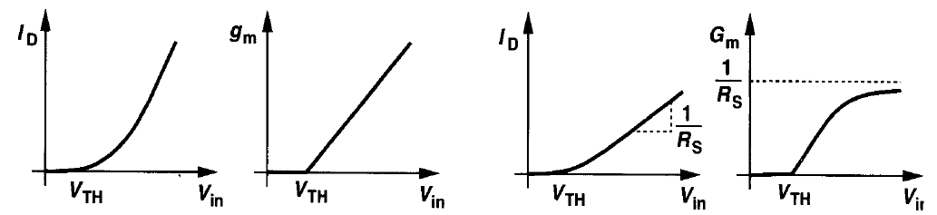
UNIT II HIGH FREQUENCY CMOS AMPLIFIERS AND CURRENT MIRROR CIRCUITS
CS with Source Degeneration
Drain Current and Transconductance
Without Source Degeneration
With Source Degeneration
G
D
x
I_{x}
Output Resistance:
I_{r0}
I_{D}
r_{o}
V_{x}
g_{m} V_{gs}
g_{mb} V_{bs}
R_{D}
S
I_{out}
R_{s}

Slide 31
UNIT II HIGH FREQUENCY CMOS AMPLIFIERS AND CURRENT MIRROR CIRCUITS
CS with Source Degeneration
I_{x} = g_{m} V_{gs} + g_{mb} V_{bs} + (V_{x} – V_{s})/r₀
------- (9)
I_{x} = g_{m} (V_{g} –V_{s}) + ηg_{m} (V_{b}-V_{s}) + (V_{x} – V_{s})/r₀
------- (10)
V_{s} = I_{x}R_{s}; r₀ = V_{x}/I_{x} ; V_{b} = V_{g} =0
Using the above in (10) we get,
I_{x} = g_{m} (0 –I_{x}R_{s}) + ηg_{m} (0 - I_{x}R_{s}) + (V_{x} – I_{x}R_{s})/r₀
------- (11)
I_{x} (1 + g_{m} R_{s} + ηg_{m} R_{s} + R_{s}/r₀) =V_{x}/r₀
------- (12)
R₀ = V_{x}/I_{x} = (r₀ + g_{m} R_{s} r₀ + ηg_{m} r₀ R_{s} + R_{s})
------- (13)
R₀ = V_{x}/I_{x} = (r₀+ g_{m} r₀R_{s} (1+ η) + R_{s})
------- (14)
R_{out} = R_{D} || R₀

Slide 32
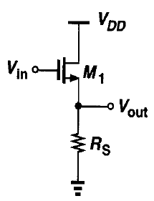
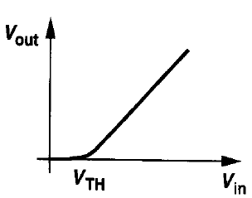
UNIT II HIGH FREQUENCY CMOS AMPLIFIERS AND CURRENT MIRROR CIRCUITS
Source Follower (Common Drain)
To achieve a high voltage gain with limited supply voltage, the load impedance must be as large as possible.
If such a stage is to drive a low-impedance load, then a "buffer" must be placed after the amplifier so as to drive the load with negligible loss of the signal level.
The source follower (also called the "common-drain" stage) can operate as a voltage buffer.
The source follower senses the signal at the gate and drives the load at the source, allowing the source potential to “follow” the gate voltage. Hence, it is called Source Follower.
When
V_{in} = 0, M₁ is Off and V_{out} =0
V_{in} >V_{th} then M₁ is in Saturation and V_{out} = V_{in}.
Here,
V_{b} ≠ V_{s}
ஃ body effect exists.
Source Follower
Input Output Characteristics

Slide 33
UNIT II HIGH FREQUENCY CMOS AMPLIFIERS AND CURRENT MIRROR CIRCUITS
Source Follower (Common Drain)
The equivalent circuit is,
G
D
r_{o}
R_{s}
g_{m} V_{gs}
g_{mb} V_{bs}
S
Source Follower
V_{x}

Slide 34
UNIT II HIGH FREQUENCY CMOS AMPLIFIERS AND CURRENT MIRROR CIRCUITS
Source Follower (Common Drain)
The Output resistance is ,
I_{x} + g_{m} V_{gs} + g_{mb} V_{bs} = V_{x}/r₀
------- (1)
I_{x} + g_{m} (V_{g} –V_{s}) + ηg_{m} (V_{b}-V_{s}) = V_{x}/r₀
------- (2)
V_{s} = V_{x}; V_{b} = V_{g} =0
Using the above in (2) we get,
I_{x} + g_{m} (0 – V_{x}) + ηg_{m} (0 - V_{x}) = V_{x}/r₀
------- (3)
I_{x} - g_{m} V_{x} - ηg_{m} V_{x} = V_{x}/r₀
------- (4)
I_{x} = g_{m} V_{x} (1+ η) + V_{x}/r₀
------- (5)
R_{out} = V_{x}/I_{x} = {1/((1/r₀) +g_{m} (1+ η))}
------- (6)
R_{out} = V_{x} /I_{x} = r_{o} || (1/(g_{m} (1+ η)))
Since, r_{o} >> (1/(g_{m} (1+ η)))
R_{out} = V_{x} /I_{x} = 1/(g_{m} (1+ η))
------- (7)
If R_{s} is included, then
R_{out} = R_{out} || R_{s}= 1/(g_{m} (1+ η)) || R_{s}
------- (8)

Slide 35
UNIT II HIGH FREQUENCY CMOS AMPLIFIERS AND CURRENT MIRROR CIRCUITS
Source Follower (Common Drain)
The Gain of the amplifier is ,
G
D
V_{in}
r₀
g_{m} V_{gs}
g_{mb} V_{bs}
S
V_{out}
V_{g} = V_{in};
V_{s} = V_{out};
V_{b} =0;
Rs || r₀
R_{s}

Slide 36
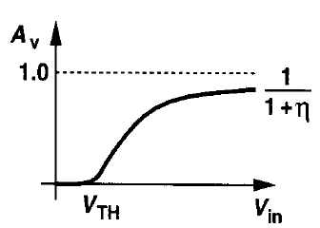
UNIT II HIGH FREQUENCY CMOS AMPLIFIERS AND CURRENT MIRROR CIRCUITS
Source Follower (Common Drain)
V_{out} = (g_{m} V_{gs} + g_{mb} V_{bs}) (r₀ || R_{s}) ------- (9)
V_{out} = (g_{m} (V_{g} -V_{s}) + ηg_{m} (V_{b}-V_{s}) (r₀ || R_{s}) ------- (10)
V_{out} = (g_{m} (V_{in} -V_{out}) + ηg_{m} (0-V_{out})) (r₀ || R_{s}) ------- (11)
V_{out} = (g_{m} V_{in} - g_{m} V_{out} - ηg_{m} V_{out}) (r₀ || R_{s}) ------- (12)
V_{out} + (g_{m} V_{out} + ηg_{m} V_{out}) (r₀ || R_{s}) = g_{m} V_{in} (r₀ || R_{s})
V_{out} (1 +(g_{m} + ηg_{m}) (r₀ || R_{s})) = g_{m} V_{in} (r₀ || R_{s}) ------- (13)
V_{out} (1 +(1+ η) g_{m} (r₀ || R_{s})) = g_{m} V_{in} (r₀ || R_{s})
A_{v} = V_{out} / V_{in} = g_{m} (r₀ || R_{s}) / (1 +(1+ η) g_{m} (r₀ || R_{s}))
------- (14)

Slide 37
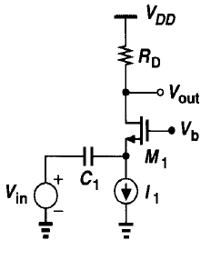
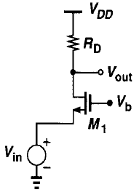
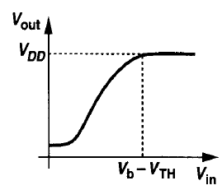
UNIT II HIGH FREQUENCY CMOS AMPLIFIERS AND CURRENT MIRROR CIRCUITS
Common Gate Amplifier
A common-gate (CG) stage senses the input at the source and produces the output at the drain.
The gate is connected to a dc voltage to establish proper operating conditions.
Note that the bias current of M₁ flows through the input signal source
Alternatively, as depicted in Fig, M₁ can be biased by a constant current source, with the signal capacitive coupled to the circuit.
I/O Characteristics
Common-gate stage with
capacitive coupling at input
Common-gate stage with
direct coupling at input

Slide 38
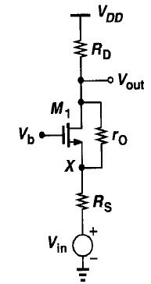
UNIT II HIGH FREQUENCY CMOS AMPLIFIERS AND CURRENT MIRROR CIRCUITS
Common Gate Amplifier
Let us consider the common gate topology with the output impedance of the transistor and input impedance of the signal source.
D
x
I_{out}
G
V_{out}
I_{r0}
I_{D}
r_{o}
g_{m} V_{gs}
g_{mb} V_{bs}
R_{D}
V_{out}
S
I_{out}
R_{s}
CG with finite output resistance
V_{s}
V_{in}

Slide 39
UNIT II HIGH FREQUENCY CMOS AMPLIFIERS AND CURRENT MIRROR CIRCUITS
Common Gate Amplifier
From the equivalent circuit,
V_{out} = Voltage drop across r₀ (V_{r0}) + Voltage drop across R_{s} (V_{s}).
V_{out} = I_{r0} r₀ + (I_{out} R_{s}+V_{in}) ------- (1)
Whereas,
I_{out} = 0 – V_{out}/R_{D} ------- (2)
Sub (2) in (1), we get,
V_{out} = I_{r0} r₀ – (V_{out} R_{s} /R_{D}) ------- (3)

Slide 40
UNIT II HIGH FREQUENCY CMOS AMPLIFIERS AND CURRENT MIRROR CIRCUITS
Common Gate Amplifier
Applying KCL at node ‘V_{out}’ of the equivalent circuit is,
I_{r0} + g_{m} V_{gs} + g_{mb} V_{bs} = I_{out}
------- (4)
I_{r0} + g_{m} (V_{g} –V_{s} ) + g_{mb} (V_{b} - V_{s}) = -V_{out}/R_{D}
------- (5)
Using, η = g_{mb}/ g_{m}; V_{b} = 0; V_{g} = 0; V_{s} = -V_{out} R_{s}/R_{D} +V_{in}
I_{r0} + g_{m} (0-V_{out} R_{s}/R_{D} +V_{in}) + ηg_{m} (0 - V_{out} R_{s}/R_{D} +V_{in}) = -V_{out}/R_{D}
------- (6)
I_{r0} = - g_{m} (V_{out} R_{s}/R_{D} -V_{in}) - ηg_{m} (V_{out} R_{s}/R_{D} –V_{in}) -V_{out}/R_{D}
------- (7)
Sub., (7) in (3),
V_{out} = [- g_{m} (V_{out} R_{s}/R_{D} -V_{in}) - ηg_{m} (V_{out} R_{s}/R_{D} –V_{in}) -V_{out}/R_{D}]r₀ – V_{out} R_{s} /R_{D} +V_{in}
V_{out} + r₀ V_{out} /R_{D} + ηg_{m} r₀( V_{out} R_{s}/R_{D}) + g_{m} r₀( V_{out} R_{s}/R_{D}) + (V_{out} R_{s} /R_{D}) = V_{in} + V_{in} r₀ g_{m} + V_{in} r₀ η g_{m}
V_{out} [1+ g_{m} r₀ R_{s}/R_{D} + ηg_{m} r₀(R_{s}/R_{D}) + r₀ /R_{D} + (R_{s} /R_{D})] = V_{in} [1+ g_{m} r₀ + ηg_{m} r₀]
A_{v} =V_{out} / V_{in} = [1+ g_{m} r₀ + ηg_{m} r₀] / [1+ g_{m} r₀ R_{s}/R_{D} + ηg_{m} r₀(R_{s}/R_{D}) + r₀ /R_{D} + (R_{s} /R_{D})]
A_{v} =V_{out} / V_{in} = R_{D}[1+ g_{m} r₀ (1 + η)] / [R_{D}+ g_{m} (1 + η)g_{m} r₀R_{s} + r₀ + R_{s})]
------- (8)

Slide 41
UNIT II HIGH FREQUENCY CMOS AMPLIFIERS AND CURRENT MIRROR CIRCUITS
Common Gate Amplifier
G
D
x
I_{x}
Output Resistance:
I_{r0}
I_{D}
r_{o}
V_{x}
g_{m} V_{gs}
g_{mb} V_{bs}
R_{D}
S
V_{S}
I_{out}
R_{s}

Slide 42
UNIT II HIGH FREQUENCY CMOS AMPLIFIERS AND CURRENT MIRROR CIRCUITS
Common Gate Amplifier
Applying KCL at node X,
I_{x} = g_{m} V_{gs} + g_{mb} V_{bs} + (V_{x} – V_{s})/r₀
------- (9)
I_{x} = g_{m} (V_{g} –V_{s}) + ηg_{m} (V_{b}-V_{s}) + (V_{x} – V_{s})/r₀
------- (10)
V_{s} = I_{x}R_{s}; R₀ = V_{x}/I_{x} ; V_{b} = V_{g} =0
Using the above in (10) we get,
I_{x} = g_{m} (0 –I_{x}R_{s}) + ηg_{m} (0 - I_{x}R_{s}) + (V_{x} – I_{x}R_{s})/r₀
------- (11)
I_{x} (1 + g_{m} R_{s} + ηg_{m} R_{s} + R_{s}/r₀) =V_{x}/r₀
------- (12)
R₀ = V_{x}/I_{x} = (r₀ + g_{m} R_{s} r₀ + ηg_{m} r₀ R_{s} + R_{s})
------- (13)
R₀ = V_{x}/I_{x} = (r₀+ g_{m} r₀R_{s} (1+ η) + R_{s})
------- (14)
R_{out} = R_{D} || R₀

Slide 43
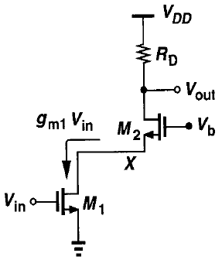
UNIT II HIGH FREQUENCY CMOS AMPLIFIERS AND CURRENT MIRROR CIRCUITS
Cascode Stage Amplifier
Common Gate: The input signal of a common-gate stage may be a current.
Common-source: a common-source arrangement converts a voltage signal to a current signal.
Cascode Stage: The cascade of a CS stage and a CG stage is called a "cascode"' topology.
M₁ generates a small-signal drain current proportional to &, and M₂ simply routes the current to RD.
M₁ the input device and M₂ the cascode device.
M₁ and M₂ carry equal currents.
The bias conditions of the cascode,
For M₁ to operate in saturation, V_{x} > V_{in} -V_{TH1}.
If M₁ and M₂ are both in saturation, then V_{x} is
V_{x} = V_{b} – V_{GS2}.
Thus, V_{b} – V_{GS2} > V_{in} -V_{TH1}.
Hence, V_{b} – V_{GS2} > V_{in} -V_{TH1} + V_{GS2}
For M₂ to be in saturation,
V_{out} >V_{b} – V_{TH2} ;
V_{out}> V_{in} -V_{TH1} + V_{GS2} – V_{TH2}
The term cascode is believed to be the acronym for "cascaded triodes"

Slide 44
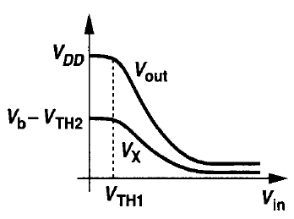
UNIT II HIGH FREQUENCY CMOS AMPLIFIERS AND CURRENT MIRROR CIRCUITS
Cascode Stage Amplifier
The minimum output level for which both transistoors operate in saturation is equal to the overdrive voltage of M₁ +M₂.
That is, addition of M₂ to the circuit reduces the output voltage swing by at least the overdrive voltage of M₂.
It means, M₂ is “Stacked” on top of M₁.
I/O Characteristics
When, V_{in} < V_{th1}; then both M₁ and M₂ are Off; V_{out} = V_{DD} & V_{x} =V_{b} – V_{th2}
V_{in}> V_{th1}; then M₁ draws current, and V_{out} drops.
Since I_{D2} increases, V_{GS2} increases and V_{x} falls down.
When, V_{in} is large then,
V_{x} drops below V_{in} by V_{th1} forcing M₁ into Triode Region (V_{x} < V_{in} – V_{th1}).
V_{out} drops below V_{b} by V_{th2}, driving M₂ into the Triode Region (V_{out} < V_{i} – V_{th2}).

Slide 45
UNIT II HIGH FREQUENCY CMOS AMPLIFIERS AND CURRENT MIRROR CIRCUITS
Cascode Stage Amplifier
Output Resistance:
G₂
D₂
x
I_{x}
I_{r0}
r_{o2}
V_{x}
g_{m2} V_{gs2}
g_{mb2} V_{bs2}
S₂
D₁
I_{out}
G₁
r₀₁
g_{m1} V_{gs1}
S₁
V_{s2} = I_{x}r_{o1}

Slide 46
UNIT II HIGH FREQUENCY CMOS AMPLIFIERS AND CURRENT MIRROR CIRCUITS
Cascode Stage Amplifier
Applying KCL at node X,
I_{x} = g_{m2} V_{gs2} + g_{mb2} V_{bs2} + (V_{x} – V_{s2})/r_{o2}
------- (1)
I_{x} = g_{m2} (V_{g2} –V_{s2}) + ηg_{m} (V_{b2}-V_{s2}) + (V_{x} – V_{s2})/r_{o2}
------- (2)
V_{s2} = I_{x}r_{o1}; R₀ = V_{x}/I_{x} ; V_{b2} = V_{g2} =0
Using the above in (2) we get,
I_{x} = g_{m2} (0 – I_{x}r_{o1}) + ηg_{m} (0 - I_{x}r_{o1}) + (V_{x} – I_{x}r_{o1})/r_{o2}
I_{x} + g_{m2}I_{x}r_{o1} + ηg_{m}I_{x}r_{o1} + I_{x}r_{o1}/r₀₂ = V_{x}/r_{o2}
------- (3)
------- (4)
I_{x} (1 + g_{m2} r_{o1} + ηg_{m} r_{o1} + r_{o1}/r₀₂) =V_{x}/r_{o2}
------- (5)
R₀ = V_{x}/I_{x} = (1 + g_{m2} r_{o1} + ηg_{m} r_{o1} + r_{o1}/r_{o2}) r_{o2}
------- (6)
R₀ = V_{x}/I_{x} = (r_{o2} + g_{m2} r_{o1} r_{o2} + ηg_{m} r_{o1} r_{o2} + r_{o1})
------- (7)
R_{out} = R_{D} || R₀
------- (8)

Slide 47
UNIT II HIGH FREQUENCY CMOS AMPLIFIERS AND CURRENT MIRROR CIRCUITS
Cascode Stage Amplifier
Voltage Gain:
G₂
D₂
x
I_{out}
V_{out}
I_{r0}
r_{o2}
g_{m2} V_{gs2}
g_{mb2} V_{bs2}
S₂
G₁
D₁
I_{out}
V_{in}
V_{g2} = 0;
V_{g1} = V_{in};
V_{s1} = 0;
V_{s2} = (I_{out} – g_{m1}V_{gs1})r_{o1}
V_{s2} = (-(V_{out}/R_{D}) – g_{m1} (V_{g1} –V_{s1}))r_{o1}
V_{s2} = (-(V_{out}/R_{D}) – g_{m1} V_{in})r_{o1}
r₀₁
g_{m1} V_{gs1}
S₁

Slide 48
UNIT II HIGH FREQUENCY CMOS AMPLIFIERS AND CURRENT MIRROR CIRCUITS
Cascode Stage Amplifier
V_{out} = Voltage drop across r₀₁ (V_{r01}) + Voltage drop across r₀₂ (V_{r02}).
V_{out} = [(-V_{out}/R_{D}) - (g_{m2} V_{gs2} + g_{mb2} V_{bs2})] r_{o2} + [(-V_{out}/R_{D}) - (g_{m1} V_{gs1})] r_{o1} ------- (9)
V_{out} = [(-V_{out}/R_{D}) r_{o2} - g_{m2} V_{gs2} r_{o2} - g_{mb2} V_{bs2} r_{o2}] + [-(V_{out} r_{o1} /R_{D}) - (g_{m1} V_{gs1}) r_{o1}] ------- (10)
V_{out} = [(-V_{out}/R_{D}) r_{o2} - g_{m2} r_{o2} [0-(-(V_{out}/R_{D}) – g_{m1} V_{in})r_{o1}]- η g_{m2} r_{o2}(-(V_{out}/R_{D}) – g_{m1} V_{in})r_{o1}] +
[-(V_{out} r_{o1} /R_{D}) - (g_{m1} V_{in}) r_{o1}] ------- (11)
V_{out}+(V_{out}/R_{D}) r_{o2} + g_{m2} r_{o1} r_{o2} (V_{out}/R_{D}) + (V_{out} r_{o1} /R_{D}) + η g_{m2} r_{o1} r_{o2}(V_{out}/R_{D}) =
- g_{m2} r_{o2} g_{m1} V_{in}r_{o1} - η g_{m2} r_{o2} g_{m1} V_{in}r_{o1} - (g_{m1} V_{in}) r_{o1} ------- (12)
V_{out} [1 + (r_{o2}/R_{D}) + (g_{m2} r_{o1} r_{o2} /R_{D}) + (r_{o1} /R_{D}) + (η g_{m2} r_{o1} r_{o2}/R_{D})] =
-V_{in} [g_{m2} r_{o2} g_{m1} r_{o1} + η g_{m2} r_{o2} g_{m1} r_{o1} + g_{m1} r_{o1}] ------- (13)
A_{v} =V_{out} / V_{in} = - [g_{m1} r_{o1} [1+ g_{m2} r_{o2} (1 + η)]]R_{D} / [R_{D} + r_{o2} + r_{o1} + (g_{m2} r_{o1} r_{o2}) (1+ η)]
------- (14)

Slide 49
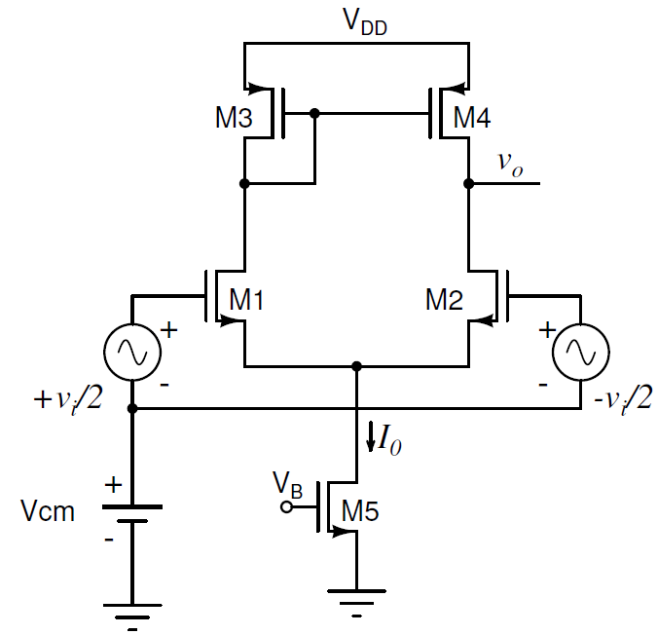
UNIT II HIGH FREQUENCY CMOS AMPLIFIERS AND CURRENT MIRROR CIRCUITS
Differential Amplifier
A differential amplifier the output signal generally is the amplified version of the difference of two inputs of the amplifier.
A source-coupled circuit as a differential voltage-to-current converter and then deal with the CMOS differential amplifier in which a current mirror circuit is employed as an active load for the source-coupled pair.
A single-ended output differential amplifier can be implemented by putting a PMOS current mirror on top of the differential amplifier.
Differential amplifier with differential input.

Slide 50
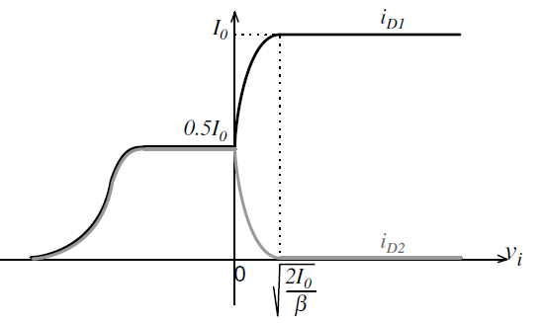
UNIT II HIGH FREQUENCY CMOS AMPLIFIERS AND CURRENT MIRROR CIRCUITS
Differential Amplifier
In this circuit, (M1, M2) and also (M3, M4) are mutually identical with each other and thus the tail current I₀ is equally divided between M1 (M3) and M2 (M4) in the absence of differential input voltage.
When v_{i} rises, due to the positive voltage gain of the amplifier, the output voltage with a steep positive slope goes up and M4 quickly approaches the triode region where the voltage gain starts dropping.
This occurs for a rather low positive change in v_{i}. After M4 enters the triode region, with more increase in v_{i}, the output voltage v_{o} continues to rise with a lower rate. At the same time the tail current steers toward M1 and the current of M2 and M4 approaches zero.
Differential amplifier drain currents versus input.

Slide 51
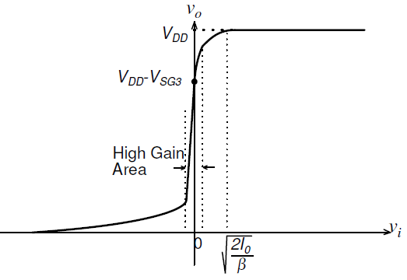
UNIT II HIGH FREQUENCY CMOS AMPLIFIERS AND CURRENT MIRROR CIRCUITS
Differential Amplifier
When differential input voltage reaches √2I₀/β, the entire tail current flows through M1 and thus M2 turns off. At this point, M4 is in triode with zero drain current, which means the drain-source voltage of M4 is zero and thus the output voltage is fixed on V_{DD}.
When input voltage changes in the negative direction, the output voltage rapidly drops again due to the differential amplifier voltage gain and this time M2 goes to the triode region.
As long as the tail transistor operates in saturation, M5 acts as a current source, and M3 with a diode connection structure always remains in saturation.
Large-signal characteristic of differential amplifier
On the other hand, if the source-to-drain voltage of M4 is more than V_{SD,sat}, it will operate in saturation and the current mirror consisting of M3 and M4 forces M1 and M2 to have the same current even though M2 is in triode and therefore the drain currents of M1 and M2 remain on I₀/2.
For large negative differential input voltage the tail transistor ultimately enters the triode region where the tail current starts decreasing with the input. As a result, the drain currents of M1 and M2 also decrease in parallel with each other.

Slide 52
UNIT II HIGH FREQUENCY CMOS AMPLIFIERS AND CURRENT MIRROR CIRCUITS
Differential Amplifier
Now let us select a widely used load consisting of a p-channel current mirror.
Under quiescent conditions (no applied differential signal, i.e., V_{ID} = 0 V), the two currents in Ml and M2 are equal and sum to I_{ss}. the current in the current sink, M5.
The current of M1 will determine the current in M3. Ideally, this current will be mirrored in M4.
If V_{GS1} = V_{GS2} and M1 and M2 are matched. then the currents in M l and M2 are equal.
Thus, the current that M4 sources to M2 should be equal to the current that M2 requires, causing i_{OUT} to be zero-provided that the load is negligible.
If these currents are not equal as in the following analysis, we assume that because the external load resistance is infinite that the current flows in the self-resistance of M2 and M4 (due to the channel modulation effect).
H V_{GS1} = V_{GS2} then i_{D1} increases with respect to i_{D2} since I_{ss} = i_{D1} + i_{D2}. This increase in i_{D1} implies an increase in i_{D3} and i_{D4}.
However, i_{D2} decreases when V_{GS1} is greater than V_{GS2} Therefore, the only way to establish circuit equilibrium is for i_{OUT} to become positive and V_{OUT} to increase.
It can be seen that if V_{GS1} < V_{GS2} then i_{OUT} becomes negative and V_{OUT} decreases.
This configuration provides a simple way in which the differential output signal of the differential amplifier can be converted back to a single-ended signal, that is, one referenced to ac ground.

Slide 53
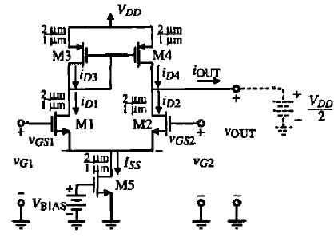
UNIT II HIGH FREQUENCY CMOS AMPLIFIERS AND CURRENT MIRROR CIRCUITS
Differential Amplifier – Small Signal Analysis
G₁
D₁, D₃, G₃, G₄
D₂, D₄
G₂
g_{m2}V_{gs2}
r_{o1}
r_{o3}
r_{o4}
r_{o2}
V_{d}/2
g_{m1} V_{gs1}
1/g_{m3}
V_{d}/2
g_{m4}V_{gs4}
S₂
Small Signal Equivalent Circuit

Slide 54
UNIT II HIGH FREQUENCY CMOS AMPLIFIERS AND CURRENT MIRROR CIRCUITS
Differential Amplifier – Small Signal Analysis
Small Signal Equivalent Circuit of M3,
V_{g} = V_{x}; V_{s3} = 0
G₃
D₃
I_{x}
Applying KCL,
I_{x} = g_{m3} V_{gs3} + V_{x}/r_{o3} ------- (1)
I_{x} = g_{m3} (V_{g3} – V_{s3}) + V_{x}/r_{o3}
I_{x} = g_{m3} (V_{x} – 0) + V_{x}/r_{o3}
I_{x} = g_{m3} V_{x} + V_{x}/r_{o3}
R_{OL} = V_{x} /I_{x} = 1/(g_{m3} || (1/r_{o3})) ------- (2)
V_{x}
r_{o3}
g_{m1} V_{gs1}
S₃
R_{OL} = V_{x} /I_{x} = 1/g_{m3} ------- (3)
V_{OUT1} = V_{D1} = V_{D3} = V_{G3} = V_{G4}
V_{OUT1} = g_{m3} V_{gs3} (r_{o1} || r_{o3} || (1/g_{m3}))
------- (14)
V_{OUT1} = g_{m3} (V_{d}/2) (1/g_{m3}) ------- (4)

Slide 55
UNIT II HIGH FREQUENCY CMOS AMPLIFIERS AND CURRENT MIRROR CIRCUITS
Differential Amplifier – Small Signal Analysis
I_{o} = i₄ - i₂ ------- (5)
I_{o} = g_{m4} V_{gs4} – g_{m2} V_{gs2} ------- (6)
I_{o} = g_{m4} (V_{g4} – V_{s4}) – g_{m2} (V_{g2} – V_{s2})
I_{o} = g_{m4} ((g_{m1}V_{d})/(2g_{m3}) – 0) – g_{m2} (-V_{d}/2 – 0)
I_{o} = (( g_{m4} g_{m1}V_{d})/(2g_{m3})) + g_{m2} V_{d}/2
I_{o} = (( g_{m4} g_{m1}V_{d})/(2g_{m3})) + g_{m2} V_{d}/2 (for identical transistors g_{m1} = g_{m2} = g_{m3} = g_{m4})
I_{o} = (g_{m4} V_{d}/2)+ (g_{m2} V_{d}/2)
I_{o} = (g_{m4} + g_{m2}) (V_{d}/2) ------- (7)
I_{o} = g_{m}V_{d} ------- (8)
Output Resistance,
R_{out} = (r_{o2} || r_{o4})
Gain A_{d} = g_{m} R_{out} = g_{m} (r_{o2} || r_{o4})

Slide 56
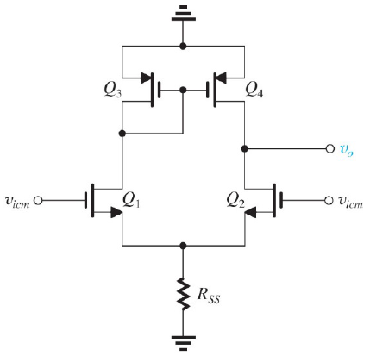
UNIT II HIGH FREQUENCY CMOS AMPLIFIERS AND CURRENT MIRROR CIRCUITS
Differential Amplifier – Common Mode Analysis
V_{icm} = V_{c} = Common Mode Signal

Slide 57
UNIT II HIGH FREQUENCY CMOS AMPLIFIERS AND CURRENT MIRROR CIRCUITS
Differential Amplifier – Common Mode Analysis
G₁
D₁, D₃, G₃, G₄
V_{o1}
D₂, D₄
V_{o2}
G₂
g_{m2}V_{gs2}
r_{o1}
r_{o3}
g_{m4}V_{gs4}
r_{o2}
V_{c}
r_{o4}
g_{mb2}V_{bs2}
g_{m1}V_{gs1}
1/g_{m3}
g_{mb1}V_{bs1}
V_{c}
2R_{ss}
2R_{ss}
S₁

Slide 58
UNIT II HIGH FREQUENCY CMOS AMPLIFIERS AND CURRENT MIRROR CIRCUITS
Differential Amplifier – Common Mode Analysis
V_{out} = (i₄ – i₂) r_{o4} ------- (9)
i₄ = g_{m4} V_{gs4} = g_{m4} (V_{g4} – V_{s4}) = g_{m4} V_{g4} ------- (10)
V_{g4} = i₁ (r_{o3} || (1/g_{m3})) ------- (11)
Sub. (11) in (10) => i₄ = g_{m4} i₁ (r_{o3} || (1/g_{m3})) ------- (12)
Sub. (12) in (9) => V_{out} = ((g_{m4} i₁ (r_{o3} || (1/g_{m3})) – i₂) r_{o4} ------- (13)
V_{c} = V_{gs} + (i₁)(2R_{ss})
V_{gs} << (i₁)(2R_{ss}) ➔ i₁ = i₂ = V_{c} / 2R_{ss} ------- (14)

Slide 59
UNIT II HIGH FREQUENCY CMOS AMPLIFIERS AND CURRENT MIRROR CIRCUITS
Differential Amplifier – Common Mode Analysis
Sub. (14) in (13),
V_{out} = ((g_{m4} (V_{c} /2R_{ss}) (r_{o3} || (1/g_{m3})) – (V_{c} /2R_{ss})) r_{o4} ------- (15)
V_{out} = (V_{c} /2R_{ss}) ((g_{m4} (r_{o3} || (1/g_{m3})) – 1) r_{o4} ------- (16)
V_{out} = (V_{c} /2R_{ss}) ((g_{m4} r_{o3} /(1+g_{m3} r_{o3})) – 1) r_{o4}
V_{out} = (V_{c} r_{o4}/2R_{ss}) (– 1/(1+g_{m3} r_{o3})) ------- (17)
Approximately,
V_{out} = (V_{c} r_{o4}/2R_{ss}) (– 1/(g_{m3} r_{o3})) ------- (18)
Since all transistors are identical, r_{o3} = r_{o4,}
Hence (18) becomes,
V_{out} = (-V_{c} /2R_{ss}g_{m3}) ------- (19)
A_{c} = V_{out} / V_{c} = (-1 /2R_{ss}g_{m}) ------- (20)

Slide 60
UNIT II HIGH FREQUENCY CMOS AMPLIFIERS AND CURRENT MIRROR CIRCUITS
Differential Amplifier – CMRR
CMRR = |A_{d}| / |A_{c}| ------- (21)
CMRR = |g_{m} (r_{o2} || r_{o4})| / |(-1 /2R_{ss}g_{m})| ------- (22)
(ஃ r_{o2} = r_{o2} = r_{o})
CMRR = g_{m}² r_{o} 2R_{ss} ------- (23)

Slide 61
UNIT II HIGH FREQUENCY CMOS AMPLIFIERS AND CURRENT MIRROR CIRCUITS
Current Mirror
Current mirrors made by using active devices have come to be widely used in analog integrated circuits both as biasing elements and as load devices for amplifier stages.
Current mirrors are frequently more economical than resistors in terms of the die area required to provide bias current of a certain value, particularly when the required value of bias current is small.
When used as a load element in transistor amplifiers, the high incremental resistance of the current mirror results in high voltage gain at low power supply voltages.
A current mirror is an element with at least three terminals, the common terminal is connected to a power supply, and the input current source is connected to the input terminal.
Ideally, the output current is equal to the input current multiplied by a desired current gain.
If the gain is unity, the input current is reflected to the output, leading to the name current mirror.
Under ideal conditions,
The current-mirror gain is independent of input frequency.
The output current is independent of the voltage between the output and common terminals (V_{ds}).
The voltage between the input and common terminals is ideally zero because this condition allows the entire supply voltage to appear across the input current source.

Slide 62
UNIT II HIGH FREQUENCY CMOS AMPLIFIERS AND CURRENT MIRROR CIRCUITS
Current Mirror
Deviations from ideality are,
The variation of the current-mirror output current with changes in voltage at the output terminal. This effected by the small-signal output resistance, Ro, of the current mirror. A Norton-equivalent model includes Ro in parallel with a current source controlled by the input current.
Gain error, which is the deviation of the gain of a current mirror from its ideal value. The gain error is separated into two parts: (1) The systematic gain error and (2) The random gain error. The systematic gain error, , is the gain error that arises even when all matched elements in the mirror are perfectly matched and will be calculated for each of the current mirrors. The random gain error is the gain error caused by unintended mismatches between matched elements.
When the input current source is connected to the input terminal of a real current mirror, it creates a positive voltage drop, V_{IN}, that reduces the voltage available across the input current source. Minimizing V_{IN} is important because it simplifies the design of the input current source, especially in low-supply applications.
A positive output voltage, V_{OUT}, is required in practice to make the output current depend mainly on the input current. This characteristic is summarized by the minimum voltage across the output branch, V_{OUT}(min), that allows the output device(s) to operate in the active region. Minimizing V_{OUT}(min) maximizes the range of output voltages for which the current-mirror output resistance is almost constant.

Slide 63
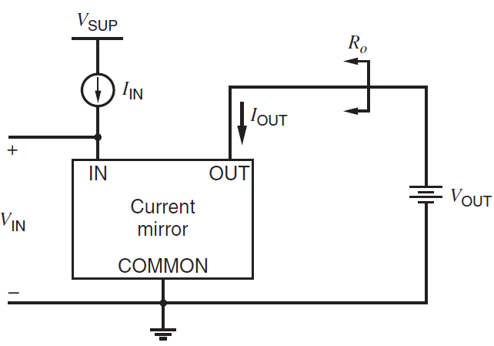
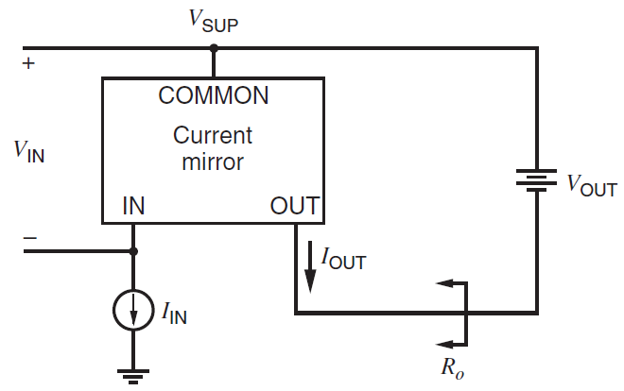
UNIT II HIGH FREQUENCY CMOS AMPLIFIERS AND CURRENT MIRROR CIRCUITS
Current Mirror
Ground referenced Current-mirror
Positive supply referenced Current-mirror

Slide 64
UNIT II HIGH FREQUENCY CMOS AMPLIFIERS AND CURRENT MIRROR CIRCUITS
Current Mirror
Types of Current mirrors are,
Simple Current Mirror
Cascode Current Mirror
Wilson Current Mirror
Widlar Current Mirror
Difference between Current Source and Current Mirror,
Current Source:
Output current depends on input current and independent on R₀ and V_{out}.
I_{out} = I_{in}
Current Mirror:
Output current independent of V_{cc} and Temperature variations.
I_{out} controlled b V_{gs2} (V_{gs2} = V_{gs1})

Slide 65
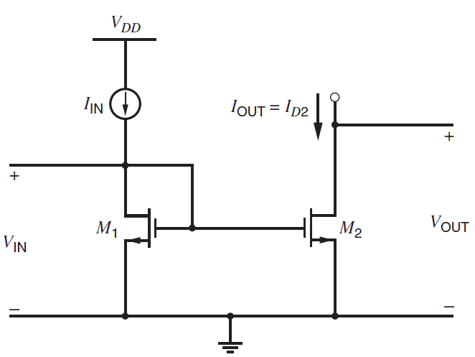
UNIT II HIGH FREQUENCY CMOS AMPLIFIERS AND CURRENT MIRROR CIRCUITS
1. Simple Current Mirror
The drain-gate voltage of M₁ is zero; therefore, the channel does not exist at the drain, and the transistor operates in the saturation or active region if the threshold is positive.
Although the principle of operation for MOS transistors does not involve forward biasing any diodes, M₁ is said to be diode connected.
Assume that M₂ also operates in the active region and that both transistors have infinite output resistance.
Then I_{D2} is controlled by V_{GS2}, which is equal to V_{GS1}.

Slide 66
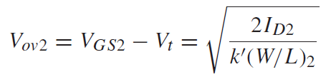
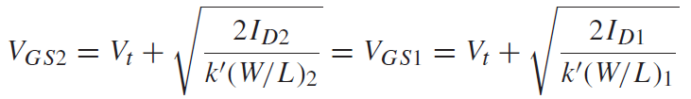



UNIT II HIGH FREQUENCY CMOS AMPLIFIERS AND CURRENT MIRROR CIRCUITS
1. Simple Current Mirror
The gate-source voltage of a given MOS transistor is usually separated into two parts:
The threshold V_{t} and the overdrive V_{ov}.
------- (1)
------- (2)
Equation (2) shows that the overdrive of M₂ is equal to that of M₁.
------- (3)
If the transistors are identical, (W/L)2 = (W/L)1, and therefore (2) is,
------- (4)

Slide 67

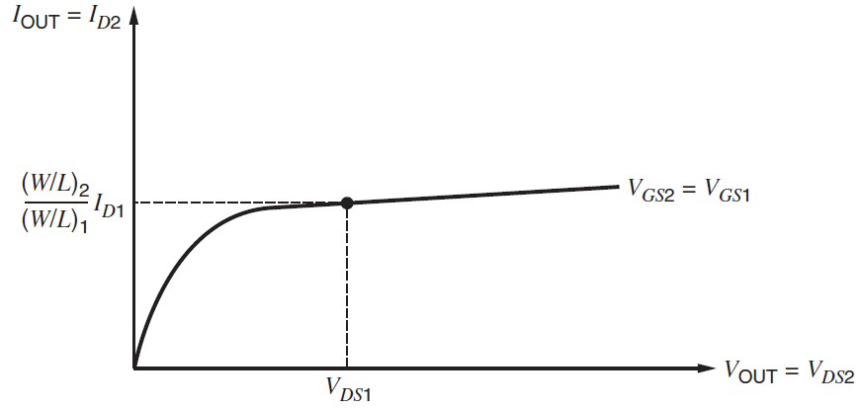

UNIT II HIGH FREQUENCY CMOS AMPLIFIERS AND CURRENT MIRROR CIRCUITS
1. Simple Current Mirror
In practice, the devices need not be identical.
------- (5)
The output resistance of the current mirror at any given operating point is the reciprocal of the slope of the output characteristic at that point.
The point where V_{DS2} = V_{DS1} and V_{GS2} = V_{GS1} is labeled on the characteristic.
------- (6)

Slide 68

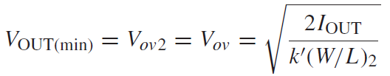
UNIT II HIGH FREQUENCY CMOS AMPLIFIERS AND CURRENT MIRROR CIRCUITS
1. Simple Current Mirror
1. The systematic gain error, ε of the current mirror can be calculated
Example:
If the drain-source voltage of M₁ (V_{ds1}) is held at 1.2V, and if the drain-source voltage of M₂ (V_{ds2}) is 5 V, then the systematic gain error is (5 − 1.2)/10 = 0.38 with V_{A} = 10 V.
------- (7)
2. For the simple MOS current mirror, the input voltage is
------- (8)
3. Finally, the minimum output voltage required to keep M2 in the active region is
------- (9)

Slide 69
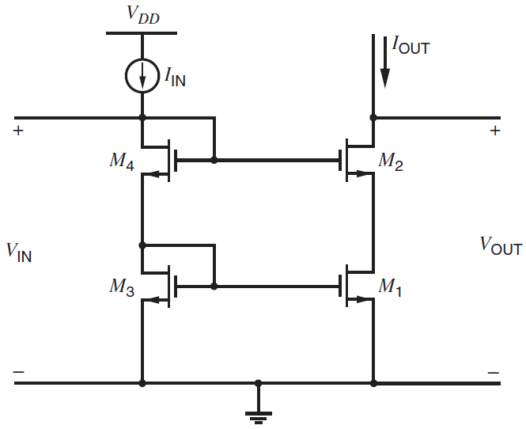
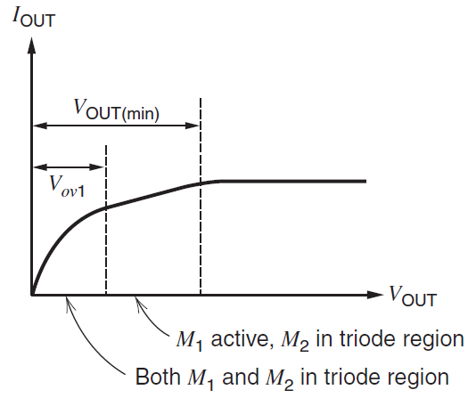
UNIT II HIGH FREQUENCY CMOS AMPLIFIERS AND CURRENT MIRROR CIRCUITS
2. Cascode Current Mirror
I-V characteristics
Cascode current mirror

Slide 70
UNIT II HIGH FREQUENCY CMOS AMPLIFIERS AND CURRENT MIRROR CIRCUITS
2. Cascode Current Mirror
Assume that all the transistors are identical. (M₁ = M₂ = M₃ = M₄)
β is infinite.
V_{GS1} = V_{GS2} = V_{GS3} = V_{GS4}
W.K.T.,
Also, I_{D3} = I_{D4} = I_{D2} = I_{D1}
And I_{IN} = I_{D4} + I_{G4} + I_{G2}
since IG = 0; ➔ I_{IN} = I_{D4}
Similarly, I_{S4} = I_{D3} + I_{G1} + I_{G3}
since IG = 0; ➔ I_{S4} = I_{D3} ; ➔ I_{S4} = I_{IN}
Hence,
I_{OUT} = I_{IN} = I_{D4}

Slide 71
UNIT II HIGH FREQUENCY CMOS AMPLIFIERS AND CURRENT MIRROR CIRCUITS
2. Cascode Current Mirror
D₄, G₂, G₄
D₂
r_{ds4}
r_{ds2}
g_{m4}V_{gs4}
g_{m2}V_{gs2}
I_{out}
S₂
S₄ = G₃
D₁
V_{in}
V_{out}
r_{ds3}
r_{ds1}
g_{m3}V_{gs3}
g_{m1}V_{gs1}
S₃
S₁

Slide 72
UNIT II HIGH FREQUENCY CMOS AMPLIFIERS AND CURRENT MIRROR CIRCUITS
2. Cascode Current Mirror
V_{out} = r_{ds2} (i_{out} – g_{m2} V_{gs2}) + r_{ds1} (i_{out} – g_{m1} V_{gs1})
V_{gs2} = V_{g2} – V_{s2} (V_{g2} = 0)
V_{gs2} = 0 – V_{s2} = - i_{out} r_{ds2}
V_{gs1} = 0 (Diode Connected; so, V_{g1} = 0 & V_{s1} = 0)
V_{out} = r_{ds2} (i_{out} + g_{m2} i_{out} r_{ds2}) + r_{ds1} i_{out}
V_{out} = i_{out} (r_{ds2} + g_{m2} r_{ds2}² + r_{ds1})
R_{out} = V_{out} / i_{out} = r_{ds2} (1+ g_{m2} r_{ds2} + r_{ds1})
The input voltage of the MOS cascode current mirror is,
V_{IN} = V_{GS3} + V_{GS4} (Drop across M₃ & M₄)
V_{IN} = V_{t3} + V_{ov3} + V_{t4} + V_{ov4}
(ஃV_{gs} – V_{t} = V_{ov}; V_{gs} = V_{t} + V_{ov})
V_{IN} = 2V_{t} + 2V_{ov} (All transistors are identical)
The minimum output voltage for which M₁ and M₂ operate in the active region is,
V_{OUT(min)} = V_{DS1} + V_{DS2} (Drop across M₁ & M₂)
V_{DS1} = V_{GS3} = V_{DS3}
V_{DS2} = V_{ov2} (M₂ is in active region)
V_{OUT(min)} = V_{GS3} + V_{ov2}
V_{OUT(min)} = V_{ov3} + V_{t3} + V_{ov2}
V_{OUT(min)} = 2V_{ov} + V_{t}

Slide 73
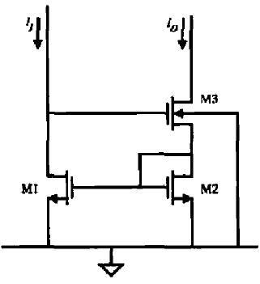
UNIT II HIGH FREQUENCY CMOS AMPLIFIERS AND CURRENT MIRROR CIRCUITS
3. Wilson Current Mirror
Assume that all the transistors are identical. (M₁ = M₂ = M₃)
I_{IN} = I_{D1} = I_{OUT} = I_{D3} = I_{S3}
r_{o3}
g_{m3}V_{gs3}
g_{mb3}V_{gs3}
I_{x}
G₃, D₁
S₃, G₂, G₁, D₂
V_{x}
I_{x}
1/g_{m2}
r_{o1}
g_{m1}V_{gs1}
S₃
S₁

Slide 74
UNIT II HIGH FREQUENCY CMOS AMPLIFIERS AND CURRENT MIRROR CIRCUITS
3. Wilson Current Mirror
V_{x} = I_{x} / g_{m2} + (I_{x} – g_{m3} V_{gs3})r_{o3} + g_{mb3} V_{bs3} r_{o3} ------- (1)
V_{x} = I_{x} / g_{m2} + I_{x}r_{o3} – g_{m3} (V_{g3} – V_{s3})r_{o3} + g_{mb3} (V_{b3} – V_{s3}) r_{o3} ------- (2)
Here, V_{g3} = - g_{m1} V_{gs1} r_{o1} (G₃ is connected to D₁ of M₁)
V_{b} = 0; V_{s1} = 0 (Bulk and Substrate connected to Ground)
V_{g1} = V_{gs2} (Gate of M₁ and M₂ connected together)
So, V_{g3} = - g_{m1} V_{gs2} r_{o1}
V_{s3} = V_{g2} = I_{x} / g_{m2} (Source of M₃ and Gate of M₂ is connected)
V_{g3} = - g_{m1} r_{o1} I_{x} / g_{m2}
Sub., above in (2),
V_{x} = I_{x} / g_{m2} + I_{x}r_{o3} – g_{m3} (- g_{m1} r_{o1} I_{x} / g_{m2} – (I_{x} / g_{m2}))r_{o3} + g_{mb3} r_{o3} (I_{x} / g_{m2}) ------- (3)
V_{x} = I_{x} [1/ g_{m2} + r_{o3} + g_{m3} r_{o3} g_{m1} r_{o1} / g_{m2} + g_{m3} r_{o3} / g_{m2} + g_{mb3} r_{o3} / g_{m2}] ------- (4)
V_{x} = I_{x} [1/ g_{m2} + r_{o3} [1 + g_{m3} g_{m1} r_{o1} / g_{m2} + g_{m3} / g_{m2} +η g_{m3} / g_{m2}]] ------- (5)
R₀ = V_{x} / I_{x} = [1/ g_{m2} + r_{o3} [1 + g_{m3} g_{m1} r_{o1} / g_{m2} + g_{m3} / g_{m2} +η g_{m3} / g_{m2}]] ------- (6)
R₀ = V_{x} / I_{x} = [g_{m3} g_{m1} r_{o1} r_{o3} / g_{m2}]

Slide 75
UNIT II HIGH FREQUENCY CMOS AMPLIFIERS AND CURRENT MIRROR CIRCUITS
3. Wilson Current Mirror
Output Resistance:
R₀ = V_{x} / I_{x} = [g_{m3} g_{m1} r_{o1} r_{o3} / g_{m2}]
Input Voltage:
V_{in} = V_{DS1} = V_{GS2} + V_{GS3} = V_{t} + V_{ov} + V_{t} + V_{ov} = 2 V_{t} + 2V_{ov}
Output Voltage:
V_{OUT} = V_{DS3} + V_{DS2} = V_{DS3} + V_{GS2} = V_{ov} + V_{t} + V_{ov} = V_{t} + 2V_{ov}

Slide 76
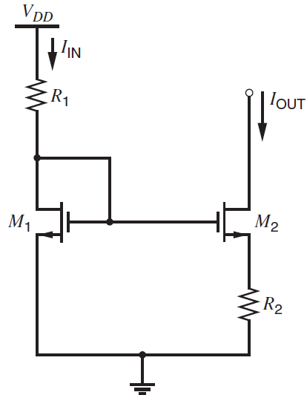
UNIT II HIGH FREQUENCY CMOS AMPLIFIERS AND CURRENT MIRROR CIRCUITS
4. Widlar Current Mirror
If I_{IN} > 0, M1 operates in the active region because it is diode connected. Assume that M₂ also operates in the forward active region.
V_{gs1} = V_{gs2} + I_{s2}R₂
I_{D2} = I_{s2} = I_{OUT}
V_{gs1} = V_{gs2} + I_{OUT} R₂
V_{t} + V_{ov1} = V_{t} + V_{ov2} + I_{OUT} R₂
V_{ov1} - V_{ov2} - I_{OUT} R₂ = 0
I_{OUT} = (V_{ov1} - V_{ov2}) / R₂ ------- (9)
_{(OR)}
V_{ov2} - V_{ov1} + I_{OUT} R₂ = 0 ------- (10)

Slide 77

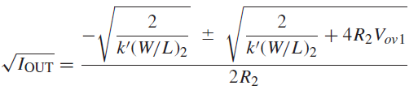
UNIT II HIGH FREQUENCY CMOS AMPLIFIERS AND CURRENT MIRROR CIRCUITS
4. Widlar Current Mirror
Use above in (10),
------- (11)
(11) is similar to ax²+bx+c = 0
------- (12)

Slide 78
UNIT II HIGH FREQUENCY CMOS AMPLIFIERS AND CURRENT MIRROR CIRCUITS
4. Widlar Current Mirror
r_{o2}
g_{m2}V_{gs2}
g_{mb2}V_{gs2}
I_{x}
G₁, D₁
D₂
V_{x}
I_{x}
R₂
R₁
r_{o1}
1/g_{m}
S₁
S₂

Slide 79
UNIT II HIGH FREQUENCY CMOS AMPLIFIERS AND CURRENT MIRROR CIRCUITS
4. Widlar Current Mirror
I_{x} = g_{m2} V_{gs2} + g_{mb2} V_{bs2} + (V_{x} – V_{s2})/r_{o2} ------- (1)
I_{x} = g_{m2} (V_{g2} – V_{s2}) + ηg_{m2} (V_{b2} – V_{s2}) + (V_{x} – I_{x}R₂)/r_{o2} ------- (2)
V_{gs2} = (V_{g2} – V_{s2}) = (0 – I_{x}R₂) (V_{g2} =0; Diode Connected)
V_{bs2} = (V_{b2} – V_{s2}) = (0 – I_{x}R₂) (V_{b2} =0; Connected to GND)
From (2)
I_{x} = g_{m2} (0 – I_{x}R₂) + ηg_{m2} (0 – I_{x}R₂) + (V_{x} – I_{x}R₂)/r_{o2} ------- (3)
I_{x} = – g_{m2} I_{x}R₂ – ηg_{m2} I_{x}R₂ + V_{x}/r_{o2} – I_{x}R₂/r_{o2} ------- (4)
I_{x} + g_{m2} I_{x}R₂ + ηg_{m2} I_{x}R₂ + I_{x}R₂/r_{o2} = V_{x}/r_{o2} ------- (5)
V_{x}/I_{x} = r_{o2} [1+g_{m2} R₂ + ηg_{m2} R₂ + R₂/r_{o2}] ------- (6)
V_{x}/I_{x} = r_{o2} [1+(1+η)g_{m2} R₂ + R₂/r_{o2}] ------- (7)

Slide 80
UNIT II HIGH FREQUENCY CMOS AMPLIFIERS AND CURRENT MIRROR CIRCUITS
4. Widlar Current Mirror
Output Resistance:
R₀ = V_{x} / I_{x} = r_{o2} + (1+η)g_{m2} r_{o2} R₂ + R₂
R₀ = V_{x} / I_{x} = r_{o2} [(1+η)g_{m2} R₂]
Input Voltage:
V_{in} = V_{GS} = V_{t} + V_{ov}
Output Voltage:
V_{OUT} = V_{DS2} + V_{S} = V_{ov2} + V_{S}

